Slide 1
BIA Capstone Project
USED CARS

Slide 2

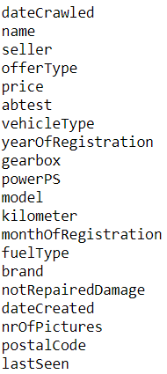
Understanding the Data – Used cars sale value
The Goal is to predict the value of used cars. The following attributes are given which have influence on the price of the car:

Slide 3

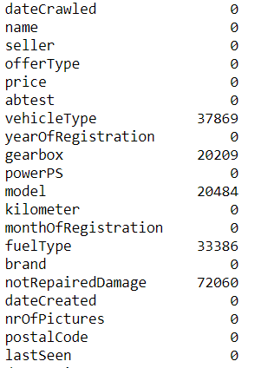
Finding out completeness of Data
Using Python code cars.isna().sum() we were able to generate attributes containing missing values.

Slide 4
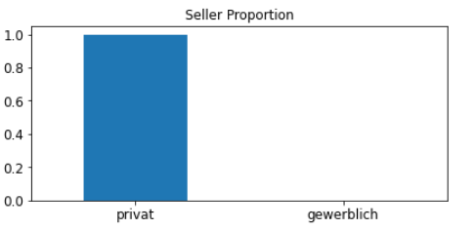
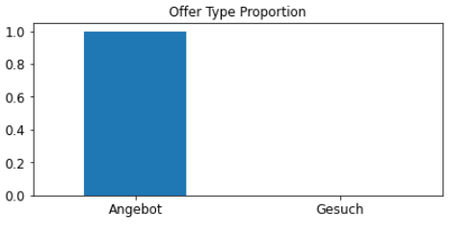
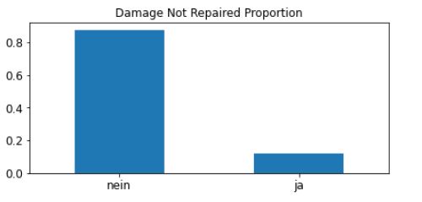
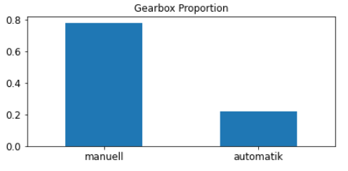
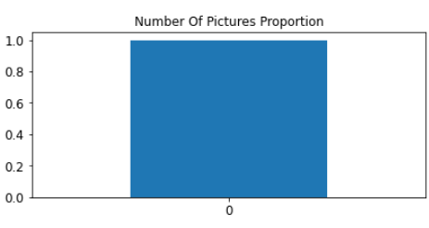
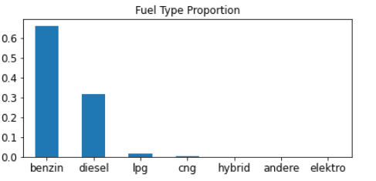
Exploratory Data analysis
Aim : To find out which attributes are essential in determining the sale value of used car:
Using matplot lib in python we derived the following visualizations to ascertain the importance of attributes:
From above plot we can see that seller, offerType and nOfPictures are very sparse with more than 99.99% being of one particular category. Such variable will have no effect on model performance and hence we drop these features. Also abtest variable does not provide any meaningful information to predict the price of the vehicle. We also remove dateCrawled, dateCreated and lastSeen features which are less important for our problem to predict price.

Slide 5
Exploratory Data analysis contd…
Aim is now to determine if there are any outliers:
Using matplotlib we further analysed outliers by using box plot and finding out percentiles and concluded the following:
The 99.5th percentile of the price data is 47600, so we drop the rows with price greater than 47695 since it indicates there is noise in data or this data refers to a highly luxury vehicle category which does not represent the 99.5% of our data. Including this data in model will cause the model to necessarily fit to these noises and overfit on train data. The number of observations are 1340 which we can remove since it forms part of only 0.5% of data.
We can see that we have price starting from 0, which does not seem to be correct information, by looking the data we can understand that those vehicles having registration year in 1990s have very low price of order of 50-100. Hence we drop the rows with price less than 50.
Many observations have power values either 0 or very high which does not seem feasible. Hence we choose the values between 10 and 500 which are 11th and 99.5th percentile respectively.
kilometer feature has range from 5000 to 150000, with 65% of the values are 150000, this seems to be real value hence we do not modify this feature

Slide 6
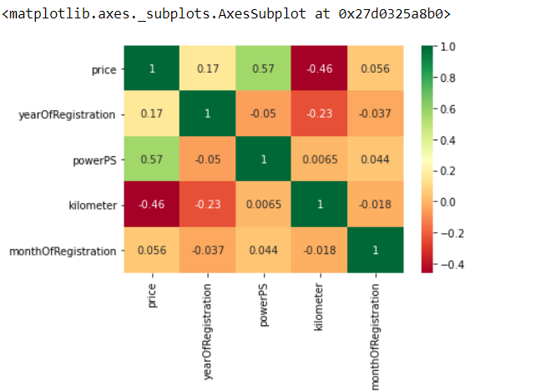
Imputing missing values
NotRepairedDamage column is easy to impute with mode
We have 4 categorical variables left now with missing values - vehicleType, model, gearbox, fuelType
To impute the categorical variable we use decision tree classifier – Refer python file for detailed codes
Also through one hot encoder categorical variables were converted to unique values for analysis
From the graph we found the most influential attributes for determining the sale value of Car. Since we have the year of registration we are dropping the month.

Slide 7
Importing csv into Power BI for analysis

Slide 8
Model Building
We used the following models to test the accuracy of the model:
Linear Regression – where we got 68.8% accuracy on both train and test data
Random Forest – where we got 98% accuracy on train data and 88% accuracy on test data
For detailed codes – Refer python file
Now our algorithm is ready to predict the value of used cars from 2016 to 2021

